Slide 1
Site Specific Mural Project

Slide 2
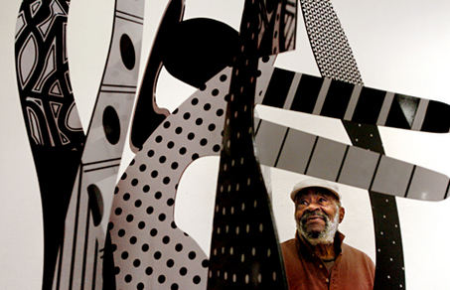
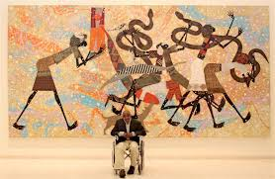
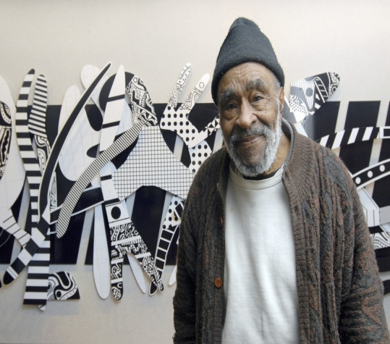
Charles McGee

Slide 3
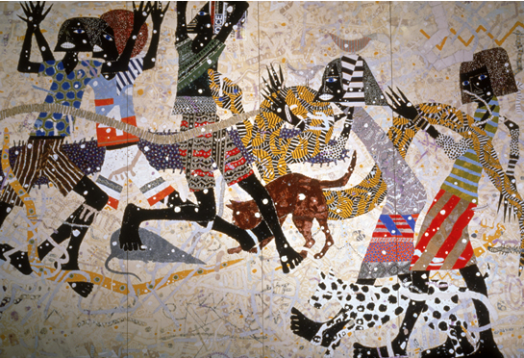
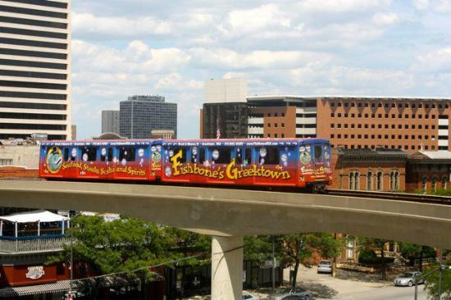
People Mover
12. Broadway Station Title: The Blue Nile Artist: Charles McGee

Slide 4
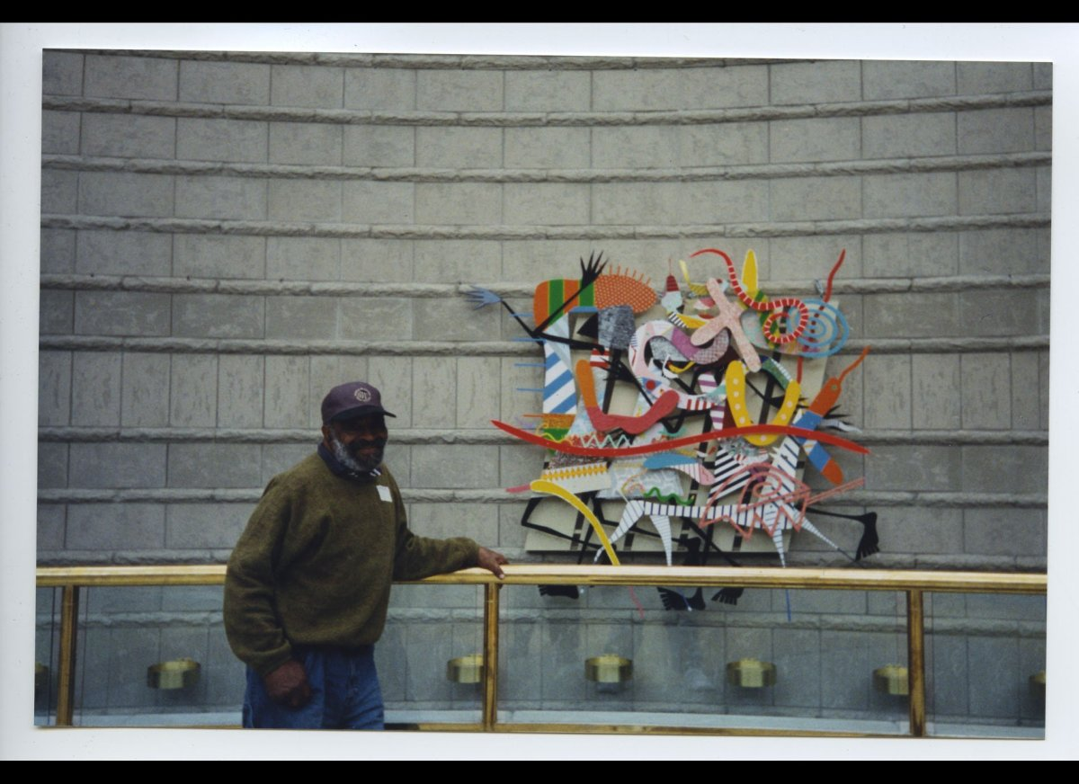
The work "Freedombound" hangs on the rotunda of the Charles H. Wright Museum of African American History. It was donated by the artist.

Slide 5
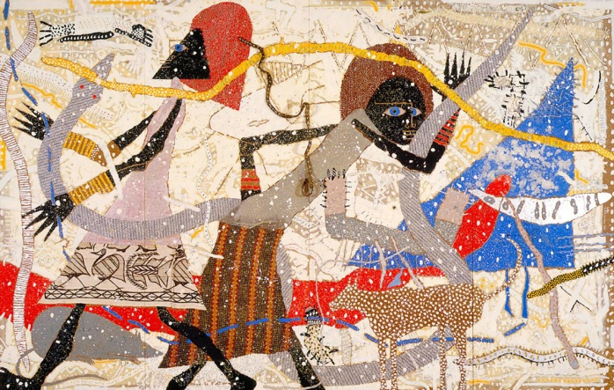
"Noah's Ark: Genesis" by Charles McGee, American, 1984. Enamel and mixed media on Masonite. Detroit Institute of Arts

Slide 6
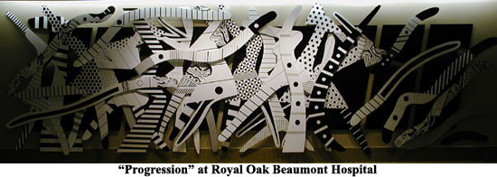

Slide 7
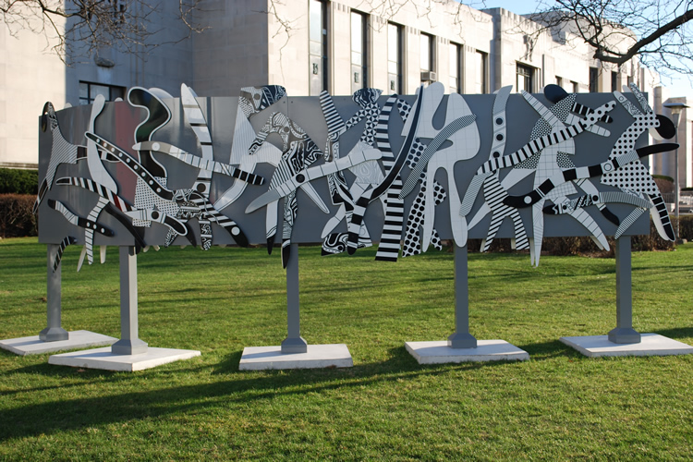
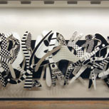
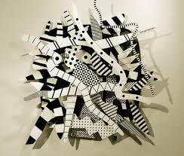
Some of the local site specific pieces around Detroit

Slide 8
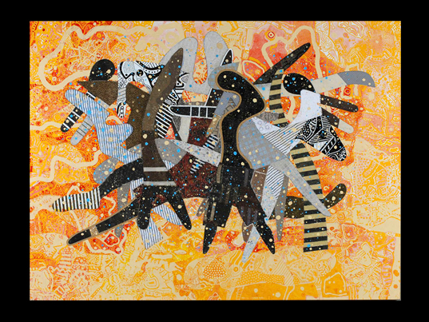
Abstract Figures

Slide 9
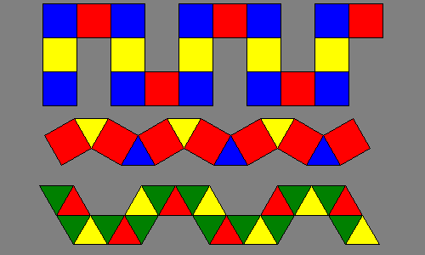
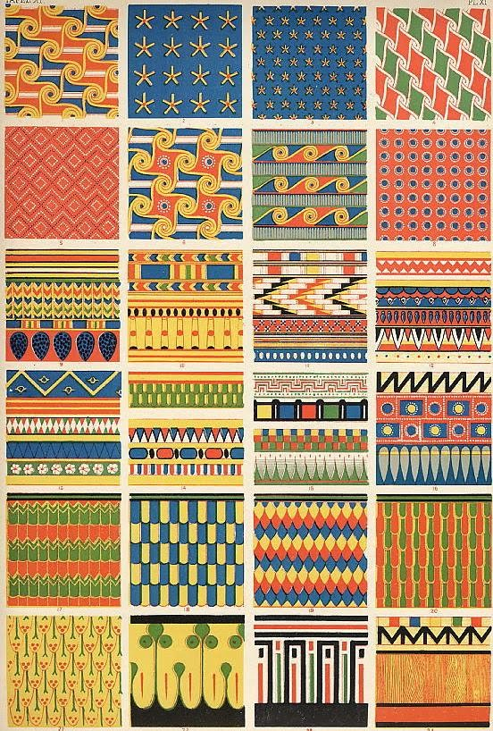
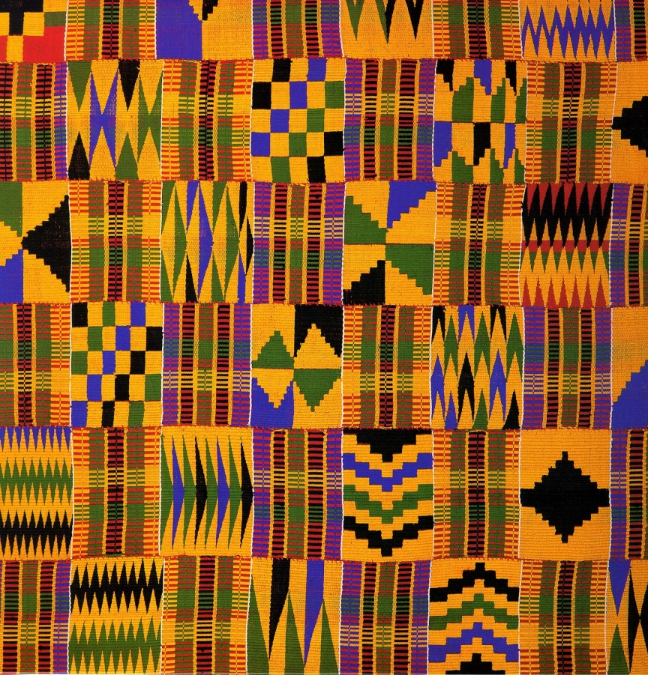
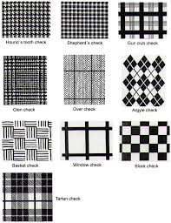
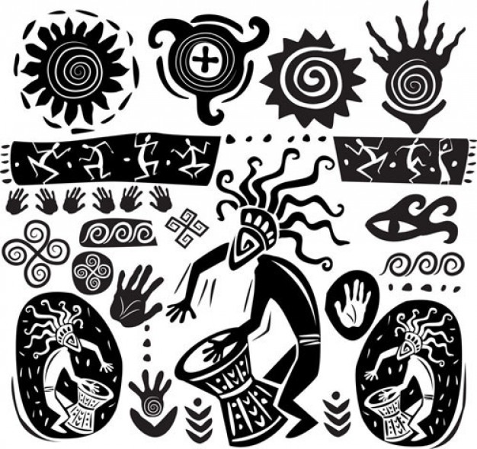
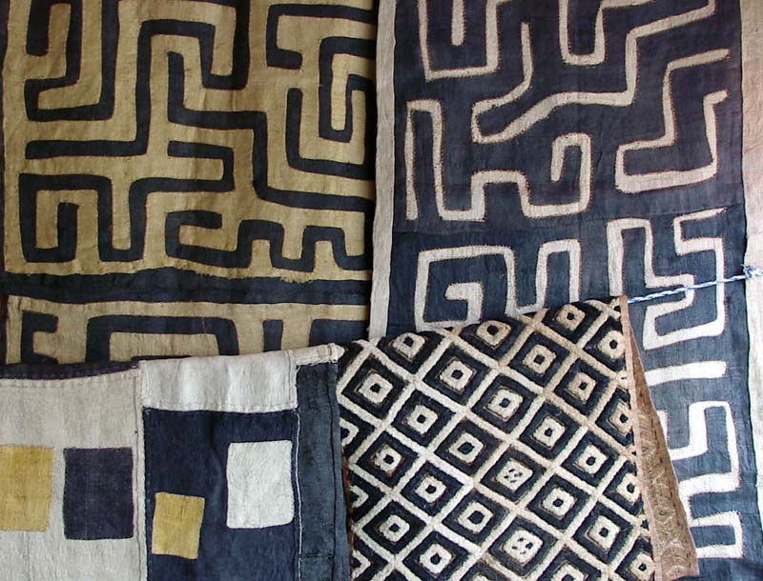
Patterns

Slide 10
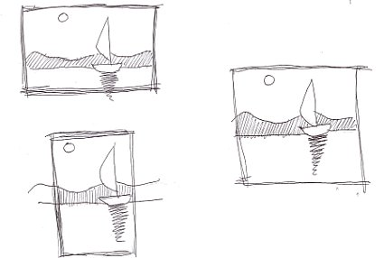
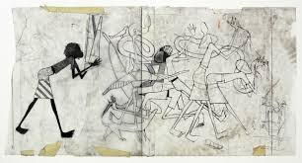
Thumbnails and rough drafts

Slide 11
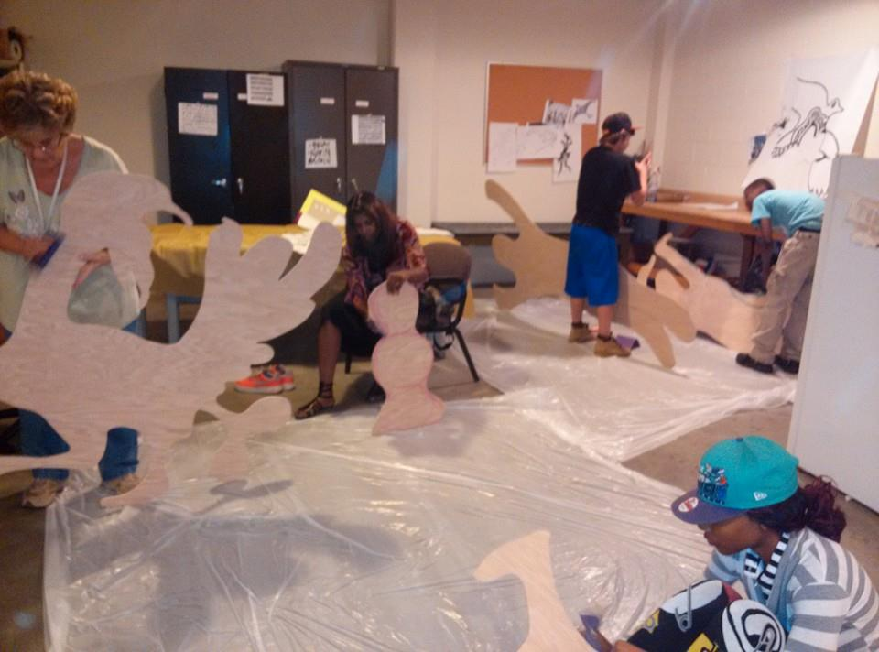
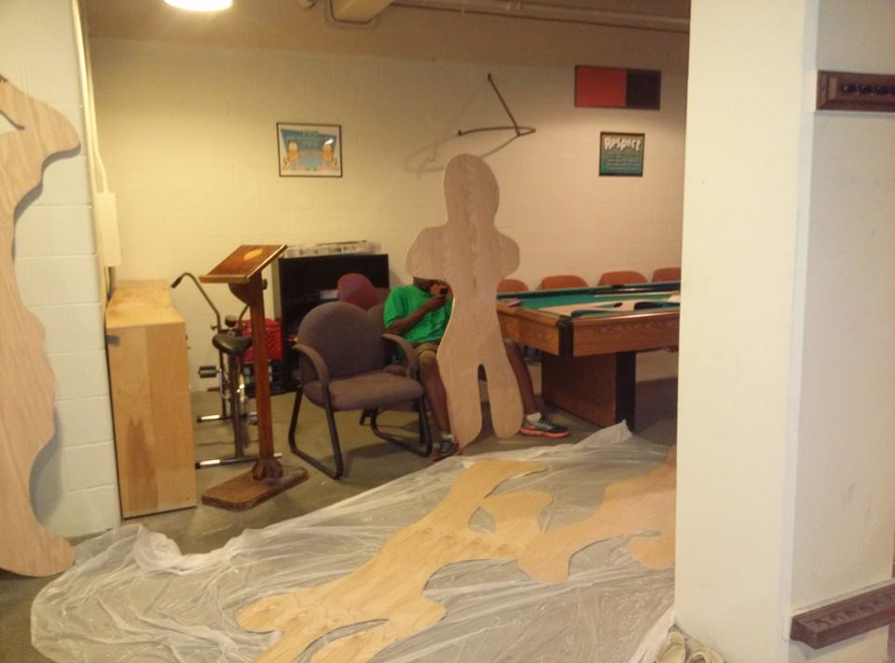
Actual size drafts then final cut out image

Slide 12
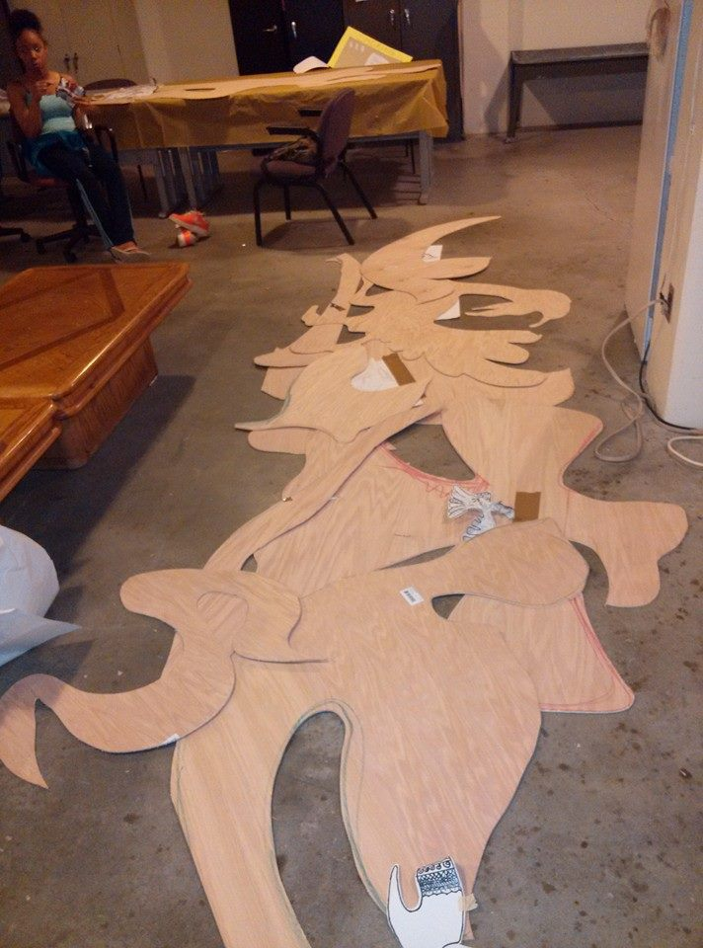
Layouts of cut outs

Slide 13
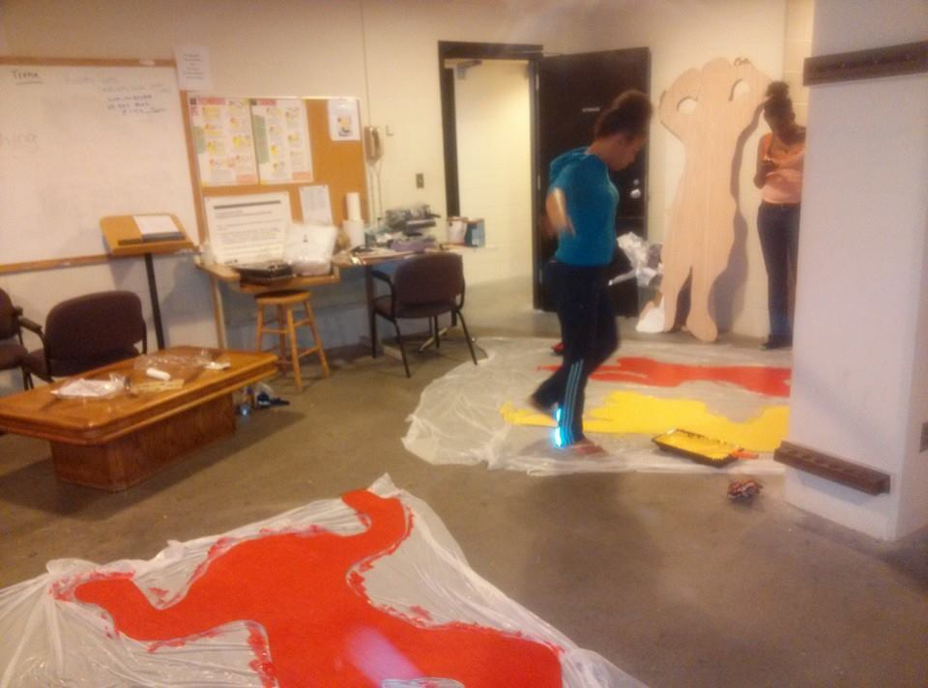
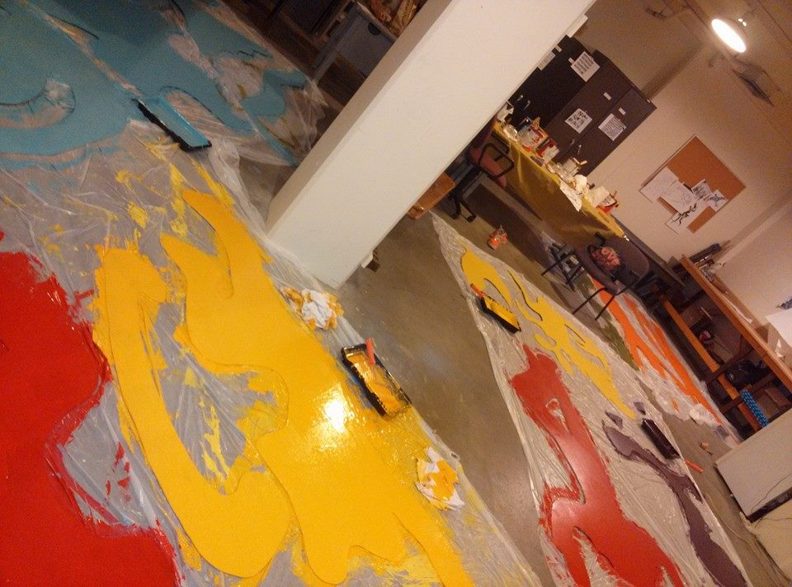
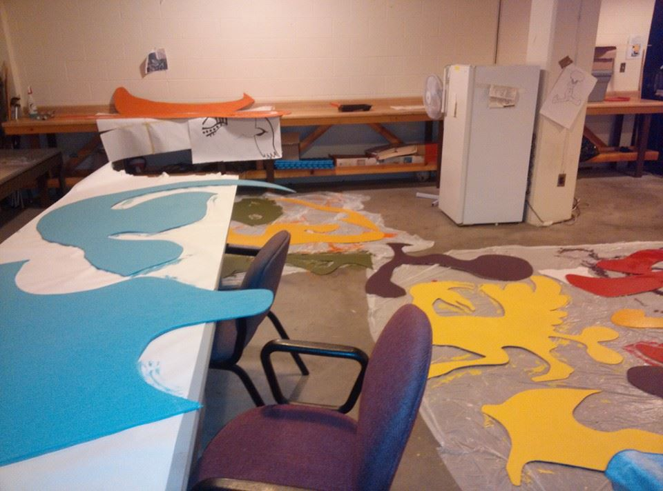
Painting of cut outs

Slide 14
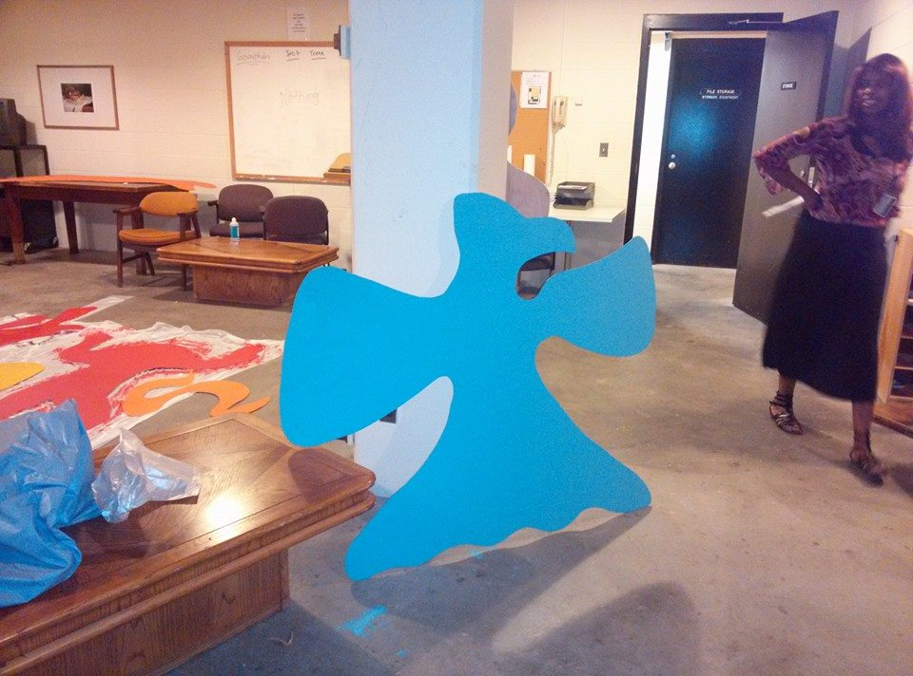
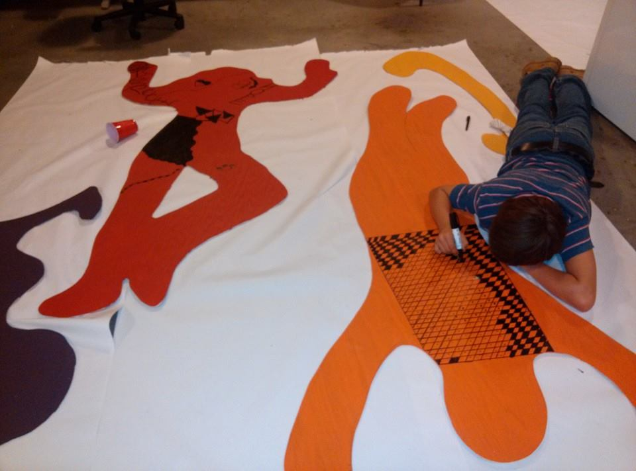
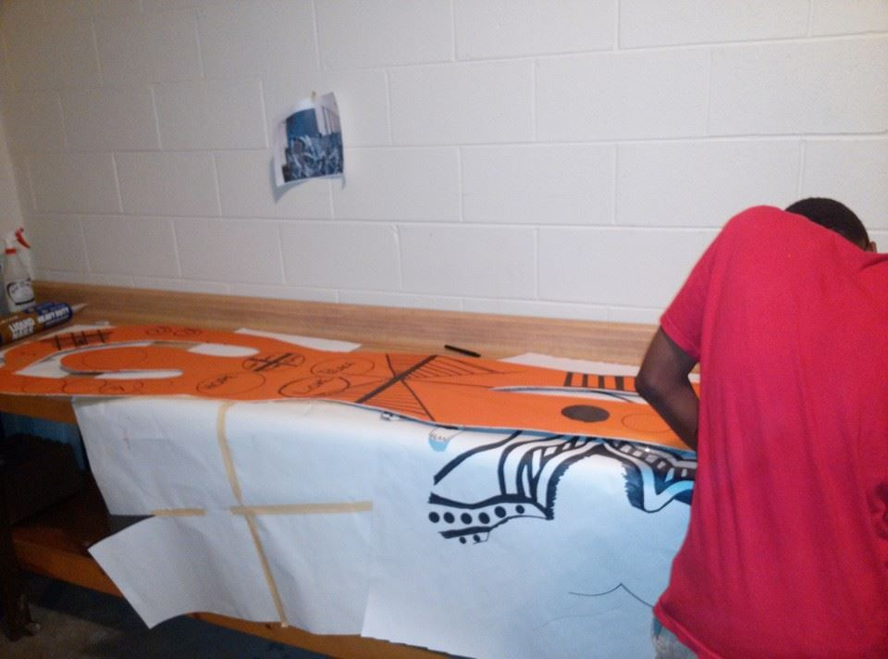
Putting the pattern work on painted designs

Slide 15
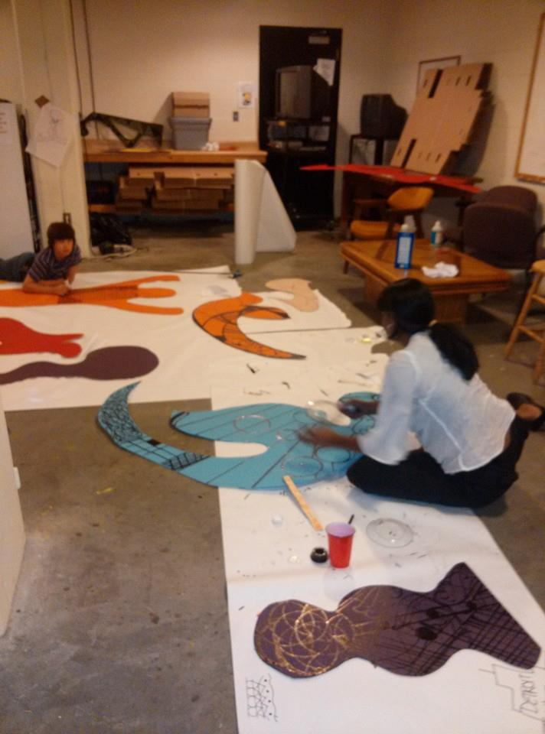
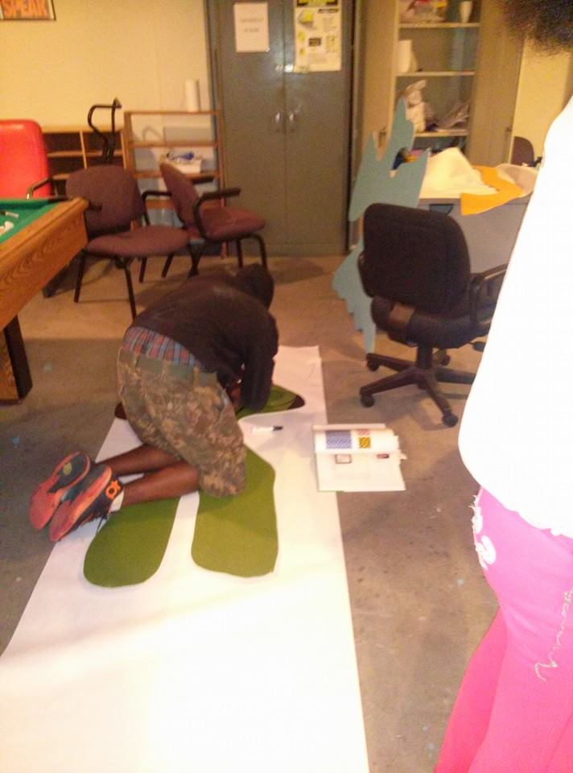

Slide 16
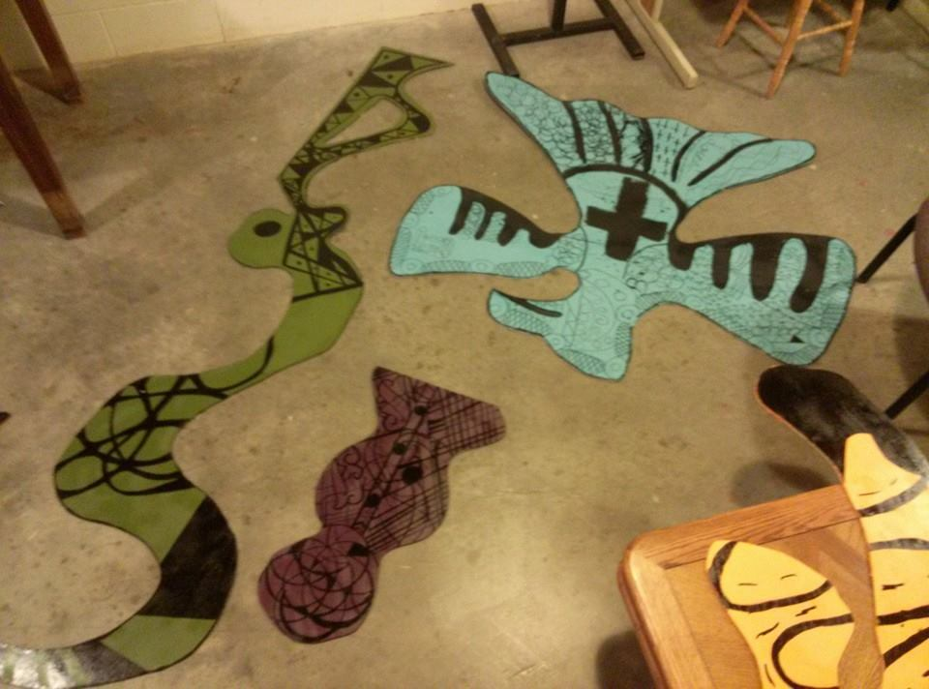
Students took their design from thumbnail sketches to finalized detailed artworks then

Slide 17
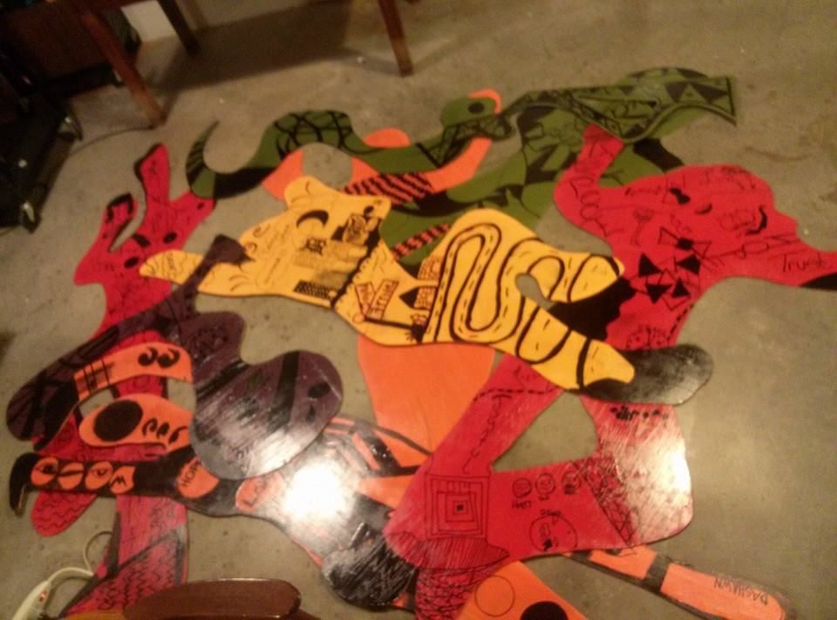
Started to collaborate into large layout

Slide 18
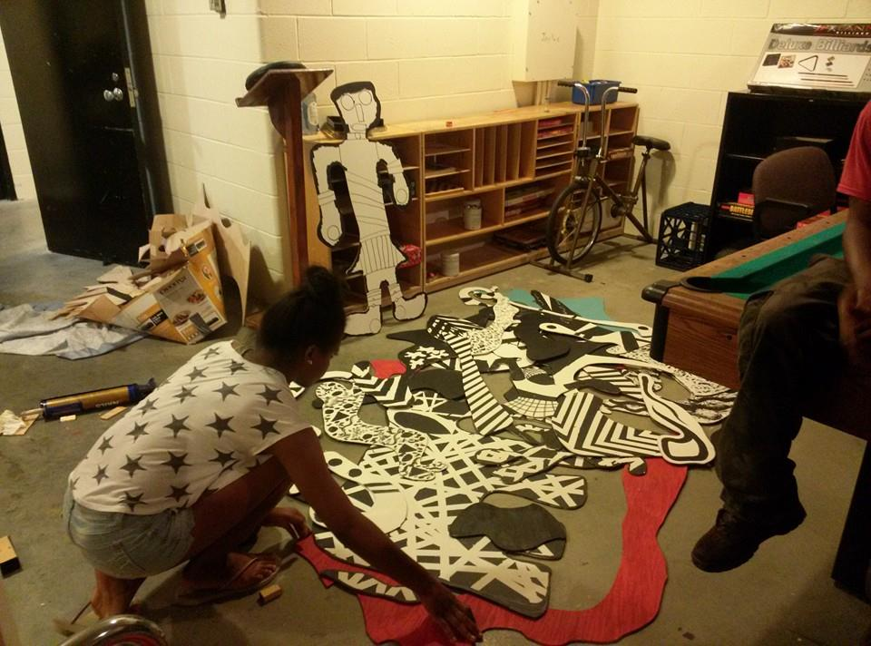

Slide 19
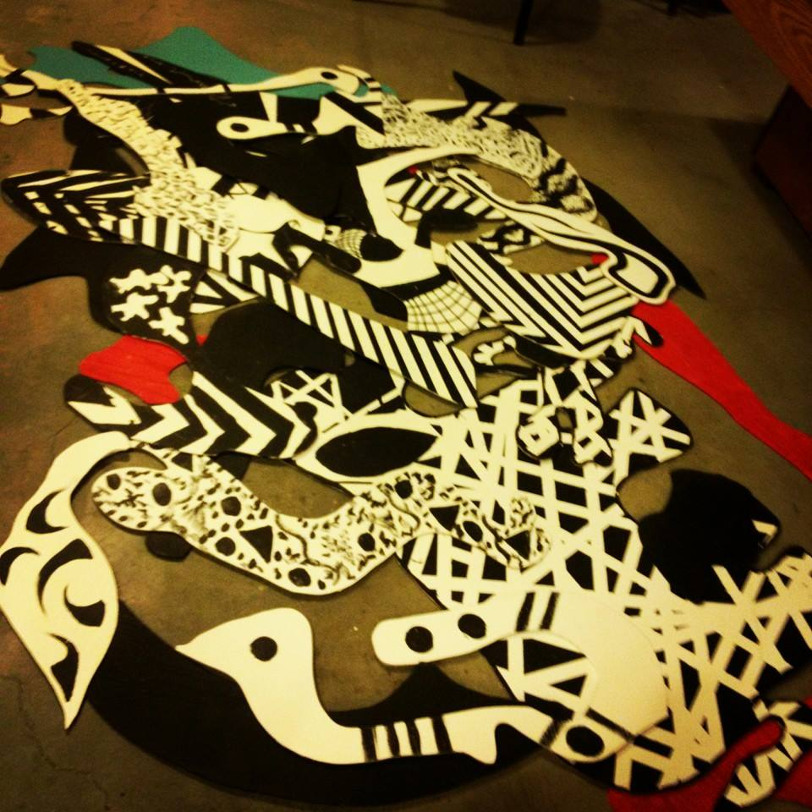

Slide 20
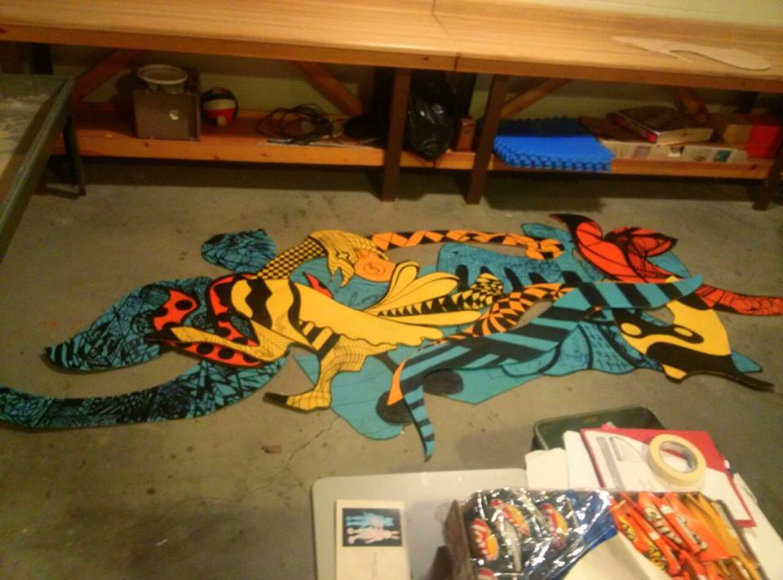
This project demonstrated how the completed mural becomes the main focus instead of a individual piece

Slide 21
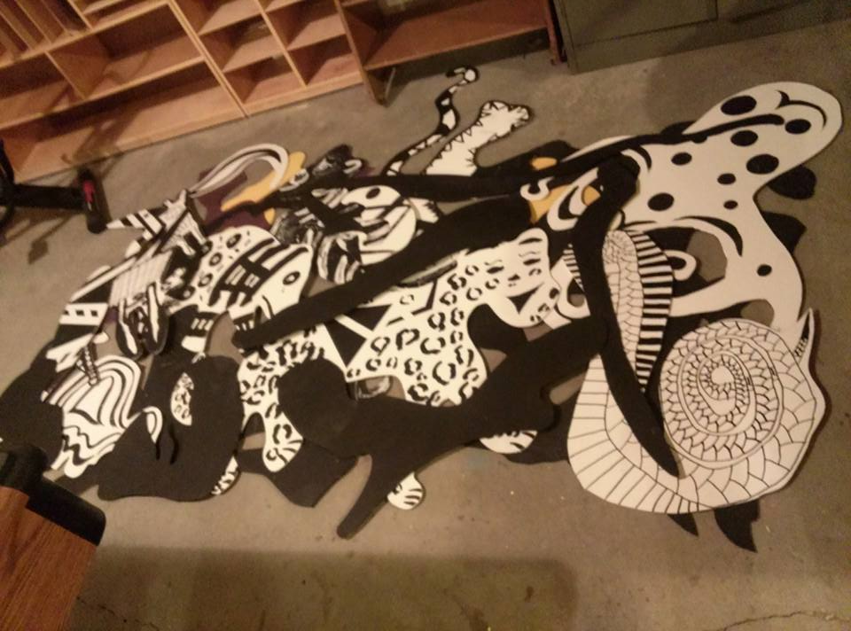
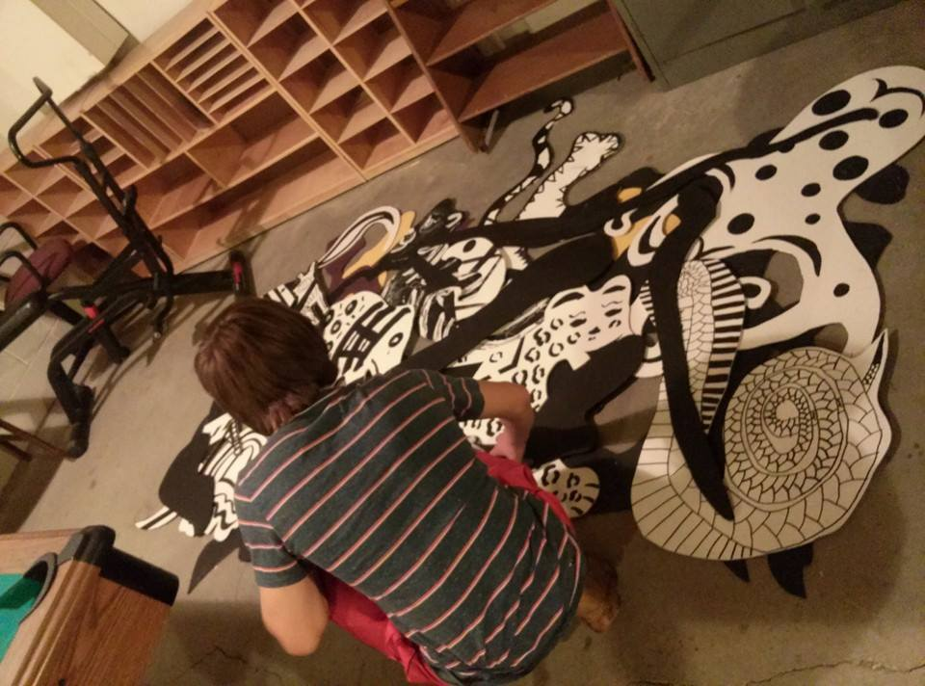

Slide 22
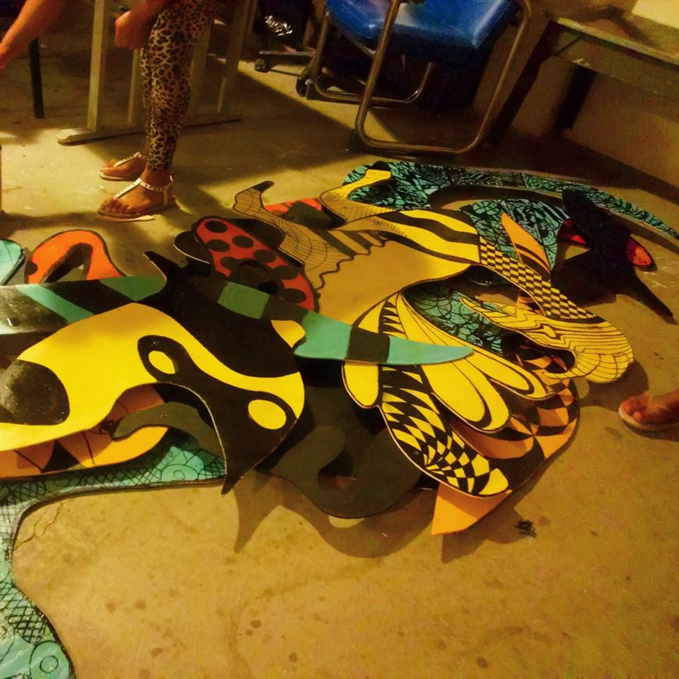
Added spacer and vanish for the three dimensional effect

Slide 23
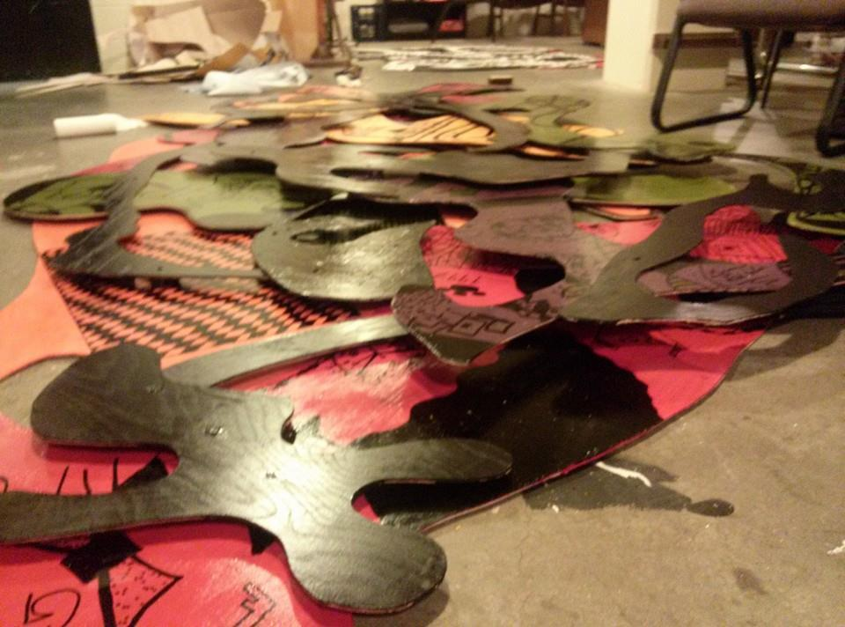

Slide 24
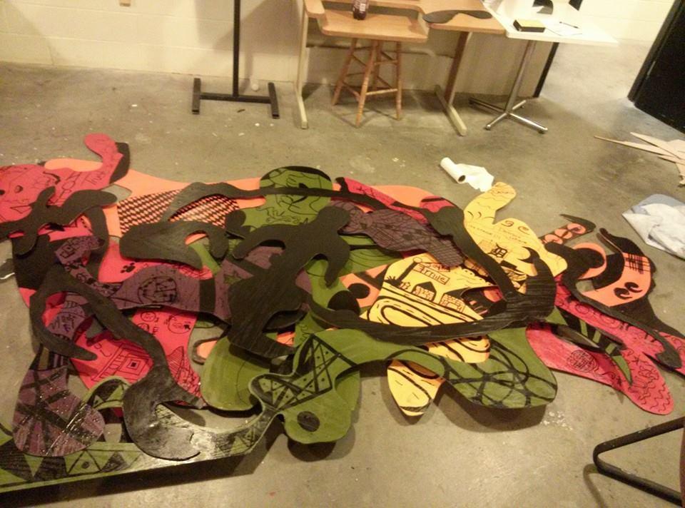
Freedom and movement- abstract figures

Slide 25
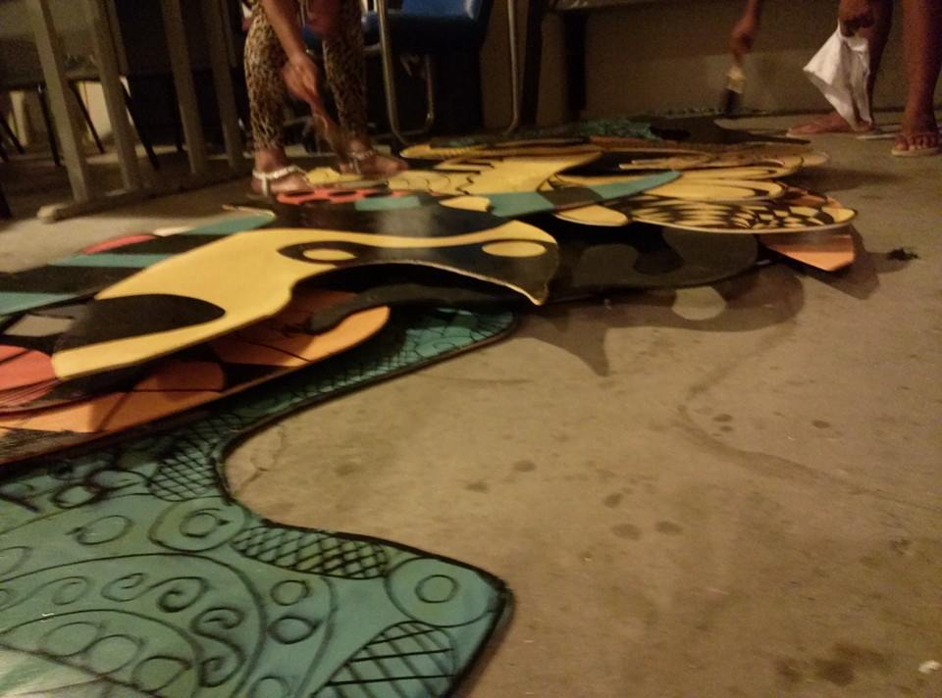
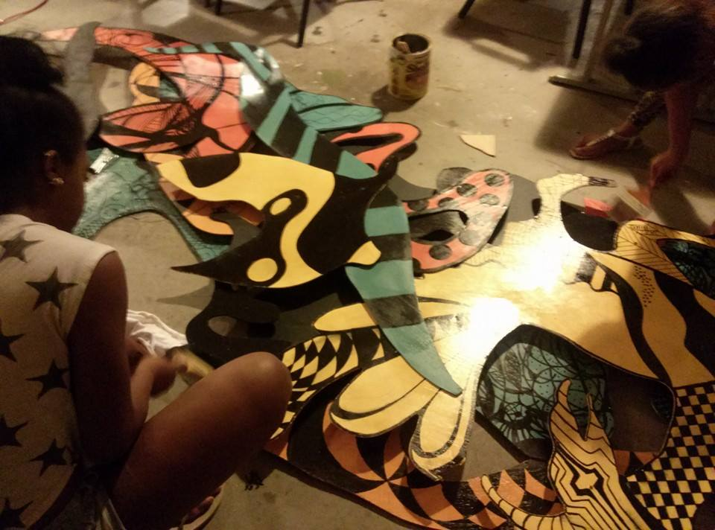
Freedom and Movement- birds and wind

Slide 26
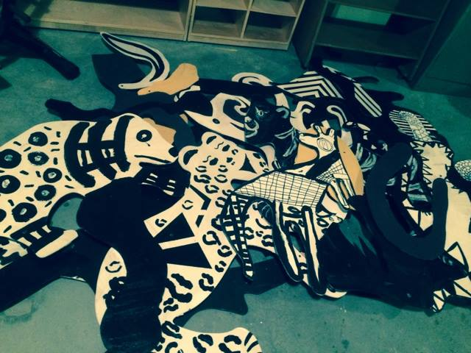
Freedom and movement- Spirit Animals and Trees

Slide 27
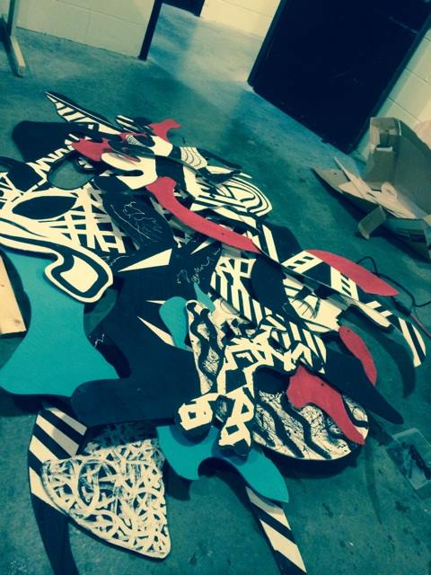
Freedom and movement Dance and movement

Slide 28
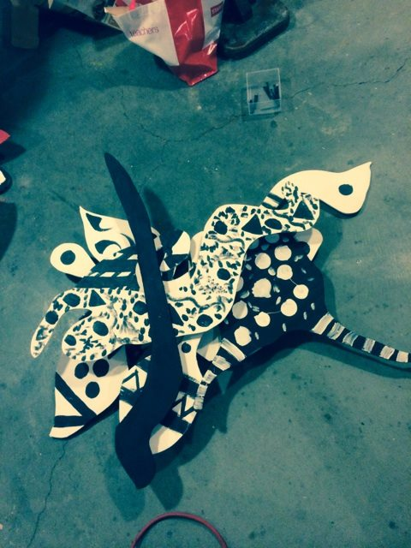

Slide 29
Special Thanks to Debra Jazz Dominic Octavia for being so involved

Slide 30
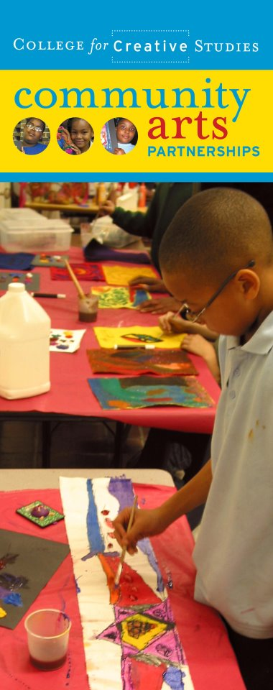
About CCS Community Arts Program
We collaborate with Detroit orgs. to create art&design education, experiences, and resources for local youth and families in support of individual and community development.
Mission
Community Arts Partnerships (CAP) collaborates with Detroit community organizations to create art and design education, experiences, and resources for local youth and families in support of individual and community development.
Description
CAP provides programs that: • Foster positive youth development through visual arts programs focused on skill development, self discovery, and self expression • Bring education in art, design, and new technologies to youth in under-resourced inner-city communities • Inform young people about career and educational opportunities in the visual arts and design • Bring the arts to bear in the re-development of the City of Detroit and its diverse neighborhoods and communities
Phone | (313) 664-1545
Email | cap@collegeforcreativestudies.edu
Website | http://capdetroit.tumblr.com

